Slide 1
Monday

Slide 2
s
a
p
n
m
d
g
o
c
t
i
k
ck
e
u
r
h
b
f
ff
ss
l
ll
j
v
w
x
y
z
zz
ch
sh
th
ai
ee
igh
oa
oo
oo
ur
ng
ar
er
qu
ow
or
oi

Slide 3
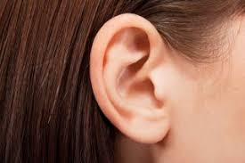
ear

Slide 4
Set 1

Slide 5
ear

Slide 6
hear

Slide 7
near

Slide 8
year

Slide 9
beard

Slide 10
ear

Slide 11
hear

Slide 12
near

Slide 13
year

Slide 14
beard

Slide 15
Set 2

Slide 16
quack

Slide 17
liquid

Slide 18
quick

Slide 19
quiz

Slide 20
quit

Slide 21
Set 3

Slide 22
can

Slide 23
little

Slide 24
into

Slide 25
too

Slide 26
in

Slide 27
Set 4

Slide 28
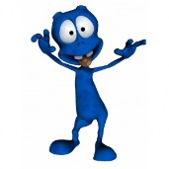
tig

Slide 29
gurp

Slide 30
chot

Slide 31
marp

Slide 32
shov

Slide 33
I can hear with my ears.

Slide 34
Tuesday

Slide 35
s
a
p
n
m
d
g
o
c
t
i
k
ck
e
u
r
h
b
f
ff
ss
l
ll
j
v
w
x
y
z
zz
ch
sh
th
ai
ee
igh
oa
oo
oo
ur
ng
ar
er
qu
ear
ow
or
oi

Slide 36
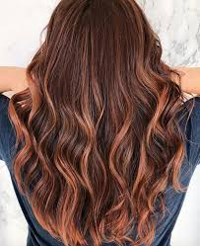
air

Slide 37
Set 1

Slide 38
air

Slide 39
hair

Slide 40
fair

Slide 41
pair

Slide 42
fair

Slide 43
air

Slide 44
hair

Slide 45
fair

Slide 46
pair

Slide 47
fair

Slide 48
Set 2

Slide 49
Set 3

Slide 50
ear

Slide 51
hear

Slide 52
near

Slide 53
year

Slide 54
beard

Slide 55
Set 4

Slide 56
nist

Slide 57
prob

Slide 58
rend

Slide 59
jup

Slide 60
nath

Slide 61
I will brush my hair now.

Slide 62
Wednesday

Slide 63
s
a
p
n
m
d
g
o
c
t
i
k
ck
e
u
r
h
b
f
ff
ss
l
ll
j
v
w
x
y
z
zz
ch
sh
th
ai
ee
igh
oa
oo
oo
ur
ng
ar
er
qu
ear
air
ow
or
oi

Slide 64
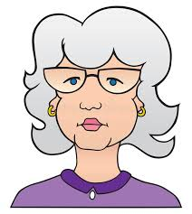
ure
mature
pure

Slide 65
Set 1

Slide 66
sure

Slide 67
pure

Slide 68
secure

Slide 69
mature

Slide 70
insecure

Slide 71
sure

Slide 72
pure

Slide 73
secure

Slide 74
mature

Slide 75
insecure

Slide 76
Set 2

Slide 77
hair

Slide 78
fair

Slide 79
pair

Slide 80
hear

Slide 81
near

Slide 82
year

Slide 83
Set 3

Slide 84
can

Slide 85
little

Slide 86
into

Slide 87
too

Slide 88
in

Slide 89
Set 4

Slide 90
stid

Slide 91
tron

Slide 92
vist

Slide 93
shap

Slide 94
moof

Slide 95
I am sure that I am mature.

Slide 96
Thursday

Slide 97
s
a
p
n
m
d
g
o
c
t
i
k
ck
e
u
r
h
b
f
ff
ss
l
ll
j
v
w
x
y
z
zz
ch
sh
th
ai
ee
igh
oa
oo
oo
ur
ng
ar
er
qu
ear
air
ow
or
oi
ure

Slide 98
ear

Slide 99
ear

Slide 100
hear

Slide 101
near

Slide 102
air

Slide 103
air

Slide 104
hair

Slide 105
fair

Slide 106
ure
mature
pure

Slide 107
sure

Slide 108
pure

Slide 109
secure

Slide 110
Friday

Slide 111
s
a
p
n
m
d
g
o
c
t
i
k
ck
e
u
r
h
b
f
ff
ss
l
ll
j
v
w
x
y
z
zz
ch
sh
th
ai
ee
igh
oa
oo
oo
ur
ng
ar
er
qu
ear
air
ow
or
oi
ure

Slide 112
Read the word twice, cover the word and write the word… ☺

Slide 113
ear

Slide 114
hear

Slide 115
quack

Slide 116
liquid

Slide 117
her

Slide 118
perk

Slide 119
pair

Slide 120
fair

Slide 121
pure

Slide 122
secure

Slide 123
The end for this week. Have a lovely weekend ! From Miss Bryant x ☺

