Slide 1
Monday

Slide 2
s
a
p
n
m
d
g
o
c
t
i
k
e
u
r
h
b
f
ff
l
ll
ck
w
x
y
z
zz
ch
ss
j
v
sh
th

Slide 3
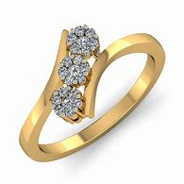
ng

Slide 4
Set 1

Slide 5
hang

Slide 6
ring

Slide 7
bang

Slide 8
sling

Slide 9
cling

Slide 10
hang

Slide 11
ring

Slide 12
bang

Slide 13
sling

Slide 14
cling

Slide 15
Set 2

Slide 16
thin

Slide 17
think

Slide 18
with

Slide 19
moth

Slide 20
cloth

Slide 21
Set 3

Slide 22
that

Slide 23
look

Slide 24
put

Slide 25
and

Slide 26
with

Slide 27
Set 4

Slide 28
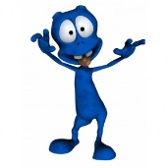
han

Slide 29
jit

Slide 30
kob

Slide 31
bith

Slide 32
chud

Slide 33
Can you cling on to the ring?

Slide 34
Tuesday

Slide 35
s
a
p
n
m
d
g
o
c
t
i
k
e
u
r
h
b
f
ff
l
ll
ck
w
x
y
z
zz
ch
ss
j
v
sh
th
ng

Slide 36
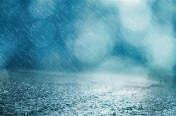
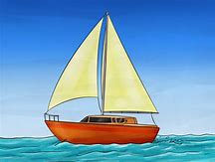
ai

Slide 37
Set 1

Slide 38
aim

Slide 39
rain

Slide 40
wait

Slide 41
sail

Slide 42
main

Slide 43
aim

Slide 44
rain

Slide 45
wait

Slide 46
sail

Slide 47
main

Slide 48
Set 2

Slide 49
hang

Slide 50
ring

Slide 51
bang

Slide 52
sling

Slide 53
cling

Slide 54
Set 3

Slide 55
that

Slide 56
look

Slide 57
put

Slide 58
and

Slide 59
with

Slide 60
Set 4

Slide 61
riz

Slide 62
seg

Slide 63
tob

Slide 64
chan

Slide 65
shuj

Slide 66
I put the sail on the main van.

Slide 67
Wednesday

Slide 68
s
a
p
n
m
d
g
o
c
t
i
k
e
u
r
h
b
f
ff
l
ll
ck
w
x
y
z
zz
ch
ss
j
v
sh
th
ng
ai

Slide 69
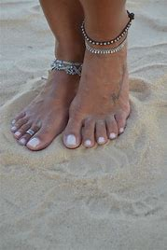
ee

Slide 70
Set 1

Slide 71
see

Slide 72
feel

Slide 73
feet

Slide 74
seem

Slide 75
meet

Slide 76
see

Slide 77
feel

Slide 78
feet

Slide 79
seem

Slide 80
meet

Slide 81
Set 2

Slide 82
aim

Slide 83
rain

Slide 84
wait

Slide 85
sail

Slide 86
main

Slide 87
Set 3

Slide 88
that

Slide 89
look

Slide 90
put

Slide 91
and

Slide 92
with

Slide 93
Set 4

Slide 94
vas

Slide 95
wid

Slide 96
yip

Slide 97
vai

Slide 98
zoch

Slide 99
Can you feel my feet?

Slide 100
Thursday

Slide 101
s
a
p
n
m
d
g
o
c
t
i
k
e
u
r
h
b
f
ff
l
ll
ck
w
x
y
z
zz
ch
ss
j
v
sh
th
ng
ai
ee

Slide 102
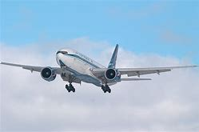
igh

Slide 103
Set 1

Slide 104
high

Slide 105
light

Slide 106
right

Slide 107
sigh

Slide 108
flight

Slide 109
high

Slide 110
light

Slide 111
right

Slide 112
sigh

Slide 113
flight

Slide 114
Set 2

Slide 115
see

Slide 116
feel

Slide 117
feet

Slide 118
seem

Slide 119
meet

Slide 120
Set 3

Slide 121
that

Slide 122
look

Slide 123
put

Slide 124
and

Slide 125
with

Slide 126
Set 4

Slide 127
blim

Slide 128
crid

Slide 129
dast

Slide 130
deez

Slide 131
pex

Slide 132
Get the flight up high.

Slide 133
Friday

Slide 134
s
a
p
n
m
d
g
o
c
t
i
k
e
u
r
h
b
f
ff
l
ll
ck
w
x
y
z
zz
ch
ss
j
v
sh
th
ng
ai
ee
igh

Slide 135
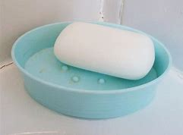
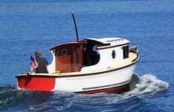
oa

Slide 136
Set 1

Slide 137
oat

Slide 138
load

Slide 139
soap

Slide 140
float

Slide 141
coats

Slide 142
oat

Slide 143
load

Slide 144
soap

Slide 145
float

Slide 146
coats

Slide 147
Set 2

Slide 148
high

Slide 149
light

Slide 150
right

Slide 151
sigh

Slide 152
flight

Slide 153
Set 3

Slide 154
that

Slide 155
look

Slide 156
put

Slide 157
and

Slide 158
with

Slide 159
Set 4

Slide 160
frip

Slide 161
gomp

Slide 162
hilk

Slide 163
vai

Slide 164
oax

Slide 165
Look! The soap floats.

Slide 166
The end for this week. Have a lovely weekend ! From Miss Bryant x ☺

