Slide 1
Monday

Slide 2
ch
sh
th
ng
ai
ee
igh
oo
ar
or
ur
ow
oi
oa
ay
oy
ear
air
ure
er
ea
ir
ou
oe
aw
/zh/
wh
ph
ue
au
qu
ou
ie
oul
ey
gn
dge
tch
kn
wr
mb
st

Slide 3
a_e
e_e
i_e
o_e
u_e
u_e

Slide 4
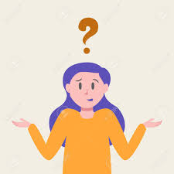
Phase 5 tricky words

Slide 5
Set 1

Slide 6
oh

Slide 7
Mrs

Slide 8
Mr

Slide 9
could

Slide 10
called

Slide 11
asked

Slide 12
people

Slide 13
looked

Slide 14
their

Slide 15
Set 2

Slide 16
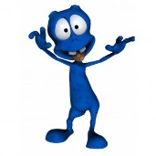
thift

Slide 17
frolp

Slide 18
kinee

Slide 19
toud

Slide 20
dergy

Slide 21
My name is Mr Smith.
The boy looked out of his window and saw Mrs Turner.
I could see lots of people when I went to the shops.

Slide 22
Tuesday

Slide 23
ch
sh
th
ng
ai
ee
igh
oo
ar
or
ur
ow
oi
oa
ay
oy
ear
air
ure
er
ea
ir
ou
oe
aw
/zh/
wh
ph
ue
au
qu
ou
ie
oul
ey
gn
dge
tch
kn
wr
mb
st

Slide 24
a_e
e_e
i_e
o_e
u_e
u_e

Slide 25
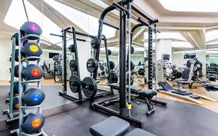
Alternative spellings
y=ee
happy
y=i
gym

Slide 26
Set 1

Slide 27
happy

Slide 28
funny

Slide 29
mummy

Slide 30
gym

Slide 31
pyramid

Slide 32
sympathy

Slide 33
happy

Slide 34
funny

Slide 35
mummy

Slide 36
gym

Slide 37
pyramid

Slide 38
sympathy

Slide 39
Set 2

Slide 40
bomb

Slide 41
lamb

Slide 42
wrap

Slide 43
rustle

Slide 44
Set 3

Slide 45
Mr

Slide 46
Mrs

Slide 47
took

Slide 48
home

Slide 49
Set 4

Slide 50
toft

Slide 51
chalp

Slide 52
kigh

Slide 53
dijd

Slide 54
frass

Slide 55
It is not sunny so I am going to the gym tonight.

Slide 56
Wednesday

Slide 57
ch
sh
th
ng
ai
ee
igh
oo
ar
or
ur
ow
oi
oa
ay
oy
ear
air
ure
er
ea
ir
ou
oe
aw
/zh/
wh
ph
ue
au
qu
ou
ie
oul
ey
gn
dge
tch
kn
wr
mb
st

Slide 58
a_e
e_e
i_e
o_e
u_e
u_e

Slide 59
Alternative spellings
ere=ear
here

Slide 60
Set 1

Slide 61
here

Slide 62
mere

Slide 63
severe

Slide 64
interfere

Slide 65
here

Slide 66
mere

Slide 67
severe

Slide 68
interfere

Slide 69
Set 2

Slide 70
happy

Slide 71
funny

Slide 72
mummy

Slide 73
gym

Slide 74
pyramid

Slide 75
sympathy

Slide 76
Set 3

Slide 77
Mr

Slide 78
Mrs

Slide 79
took

Slide 80
home

Slide 81
Set 4

Slide 82
dult

Slide 83
treelp

Slide 84
shide

Slide 85
teeck

Slide 86
margigh

Slide 87
I am standing here with a severe sore throat.

Slide 88
Thursday

Slide 89
ch
sh
th
ng
ai
ee
igh
oo
ar
or
ur
ow
oi
oa
ay
oy
ear
air
ure
er
ea
ir
ou
oe
aw
/zh/
wh
ph
ue
au
qu
ou
ie
oul
ey
gn
dge
tch
kn
wr
mb
st

Slide 90
a_e
e_e
i_e
o_e
u_e
u_e

Slide 91
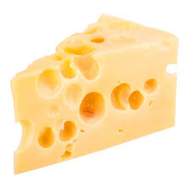
Alternative pronunciations
se=z
cheese

Slide 92
Set 1

Slide 93
cheese

Slide 94
tease

Slide 95
please

Slide 96
browse

Slide 97
because

Slide 98
cheese

Slide 99
tease

Slide 100
please

Slide 101
browse

Slide 102
because

Slide 103
Set 2

Slide 104
house

Slide 105
grease

Slide 106
purse

Slide 107
mouse

Slide 108
Set 3

Slide 109
their

Slide 110
going

Slide 111
people

Slide 112
would

Slide 113
or

Slide 114
Set 4

Slide 115
bardigh

Slide 116
nould

Slide 117
parb

Slide 118
cheed

Slide 119
zeap

Slide 120
I like eating cheese because it is yummy.

Slide 121
Friday

Slide 122
ch
sh
th
ng
ai
ee
igh
oo
ar
or
ur
ow
oi
oa
ay
oy
ear
air
ure
er
ea
ir
ou
oe
aw
/zh/
wh
ph
ue
au
qu
ou
ie
oul
ey
gn
dge
tch
kn
wr
mb
st

Slide 123
a_e
e_e
i_e
o_e
u_e
u_e

Slide 124
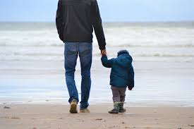
Alternative pronunciations
u=o
son

Slide 125
Set 1

Slide 126
son

Slide 127
come

Slide 128
some

Slide 129
done

Slide 130
none

Slide 131
ton

Slide 132
son

Slide 133
come

Slide 134
some

Slide 135
done

Slide 136
none

Slide 137
ton

Slide 138
Set 2

Slide 139
cheese

Slide 140
tease

Slide 141
please

Slide 142
browse

Slide 143
because

Slide 144
Set 3

Slide 145
their

Slide 146
going

Slide 147
people

Slide 148
would

Slide 149
or

Slide 150
Set 4

Slide 151
charb

Slide 152
woats

Slide 153
floost

Slide 154
phobe

Slide 155
emp

Slide 156
The Dad and his son share some sweets.

Slide 157
That is it for this week, have a lovely weekend! Miss Bryant ☺

