Slide 1
Monday

Slide 2
s
a
p
n
m
d
g
o
c
t
i
k
e
u
r
h
b
f
ff
l
ll
ck
w
x
y
z
zz
ch
ss
j
v
sh
th
ng
ai
ee
igh
oa
oo
oo
ar
or

Slide 3
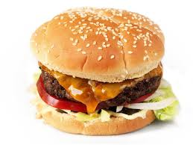
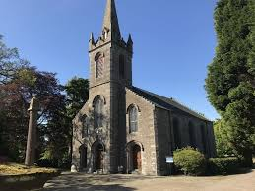
ur

Slide 4
Set 1

Slide 5
turn

Slide 6
burp

Slide 7
curl

Slide 8
hurt

Slide 9
church

Slide 10
turn

Slide 11
burp

Slide 12
curl

Slide 13
hurt

Slide 14
church

Slide 15
Set 2

Slide 16
hard

Slide 17
sort

Slide 18
car

Slide 19
farm

Slide 20
born

Slide 21
Set 3

Slide 22
he

Slide 23
we

Slide 24
me

Slide 25
all

Slide 26
were

Slide 27
Set 4

Slide 28
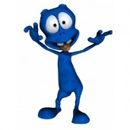
kilb

Slide 29
lang

Slide 30
zoa

Slide 31
mith

Slide 32
lox

Slide 33
We will be at the church at ten.

Slide 34
Tuesday

Slide 35
s
a
p
n
m
d
g
o
c
t
i
k
e
u
r
h
b
f
ff
l
ll
ck
w
x
y
z
zz
ch
ss
j
v
sh
th
ng
ai
ee
igh
oa
oo
oo
ar
or
ur

Slide 36
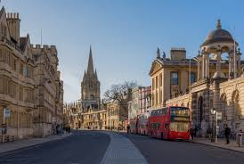
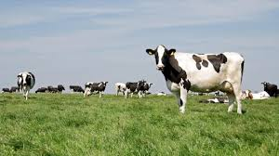
ow

Slide 37
Set 1

Slide 38
now

Slide 39
how

Slide 40
town

Slide 41
frown

Slide 42
brown

Slide 43
now

Slide 44
how

Slide 45
town

Slide 46
frown

Slide 47
brown

Slide 48
Set 2

Slide 49
turn

Slide 50
burp

Slide 51
curl

Slide 52
hurt

Slide 53
church

Slide 54
Set 3

Slide 55
he

Slide 56
we

Slide 57
me

Slide 58
all

Slide 59
were

Slide 60
Set 4

Slide 61
tig

Slide 62
gurp

Slide 63
chot

Slide 64
marp

Slide 65
shov

Slide 66
I am in the town.

Slide 67
Wednesday

Slide 68
s
a
p
n
m
d
g
o
c
t
i
k
e
u
r
h
b
f
ff
l
ll
ck
w
x
y
z
zz
ch
ss
j
v
sh
th
ng
ai
ee
igh
oa
oo
oo
ar
or
ur
ow

Slide 69
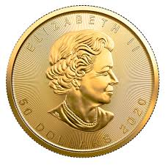
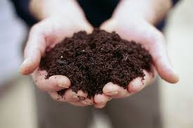
oi

Slide 70
Set 1

Slide 71
coin

Slide 72
oil

Slide 73
joint

Slide 74
soil

Slide 75
tinfoil

Slide 76
coin

Slide 77
oil

Slide 78
joint

Slide 79
soil

Slide 80
tinfoil

Slide 81
Set 2

Slide 82
art

Slide 83
hard

Slide 84
chart

Slide 85
card

Slide 86
farm

Slide 87
Set 3

Slide 88
he

Slide 89
we

Slide 90
me

Slide 91
be

Slide 92
she

Slide 93
Set 4

Slide 94
stid

Slide 95
tron

Slide 96
vist

Slide 97
shap

Slide 98
moof

Slide 99
Can I see your coin?

Slide 100
Thursday

Slide 101
s
a
p
n
m
d
g
o
c
t
i
k
e
u
r
h
b
f
ff
l
ll
ck
w
x
y
z
zz
ch
ss
j
v
sh
th
ng
ai
ee
igh
oa
oo
oo
or
ur
ow
ar
oi

Slide 102
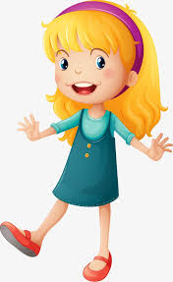
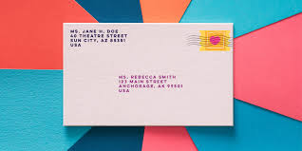
er

Slide 103
Set 1

Slide 104
her

Slide 105
perk

Slide 106
boxer

Slide 107
letter

Slide 108
her

Slide 109
perk

Slide 110
boxer

Slide 111
letter

Slide 112
Set 2

Slide 113
coin

Slide 114
oil

Slide 115
joint

Slide 116
soil

Slide 117
tinfoil

Slide 118
Set 3

Slide 119
he

Slide 120
we

Slide 121
me

Slide 122
be

Slide 123
she

Slide 124
Set 4

Slide 125
kilb

Slide 126
lang

Slide 127
zoa

Slide 128
mith

Slide 129
lox

Slide 130
I am sending a letter to her.

Slide 131
s
a
p
n
m
d
g
o
c
t
i
k
e
u
r
h
b
f
ff
l
ll
ck
w
x
y
z
zz
ch
ss
j
v
sh
th
ng
ai
ee
igh
oa
oo
oo
or
ur
ow
ar
oi
er

Slide 132
Friday

Slide 133
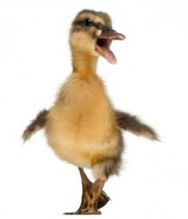
qu

Slide 134
Set 1

Slide 135
quack

Slide 136
liquid

Slide 137
quick

Slide 138
quiz

Slide 139
quit

Slide 140
quack

Slide 141
liquid

Slide 142
quick

Slide 143
quiz

Slide 144
quit

Slide 145
Set 2

Slide 146
her

Slide 147
perk

Slide 148
boxer

Slide 149
letter

Slide 150
Set 3

Slide 151
can

Slide 152
little

Slide 153
into

Slide 154
too

Slide 155
in

Slide 156
Set 4

Slide 157
kighb

Slide 158
lang

Slide 159
baif

Slide 160
mith

Slide 161
lox

Slide 162
I am going to meet the queen.

Slide 163
The end for this week. Have a lovely weekend ! From Miss Bryant x ☺

