Slide 1
Monday

Slide 2
s
a
p
n
m
d
g
o
c
t
i
k
e
u
r
h
b
f
ff
l
ll
ck
w
x
y
z
zz
ch
ss
j
v
sh
th
ng
ai
ee
igh
oa

Slide 3
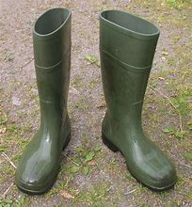
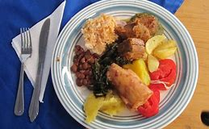
oo

Slide 4
Set 1

Slide 5
zoo

Slide 6
boom

Slide 7
boot

Slide 8
food

Slide 9
zoom

Slide 10
zoo

Slide 11
boom

Slide 12
boot

Slide 13
food

Slide 14
zoom

Slide 15
Set 2

Slide 16
oat

Slide 17
load

Slide 18
soap

Slide 19
float

Slide 20
coats

Slide 21
Set 3

Slide 22
he

Slide 23
we

Slide 24
me

Slide 25
be

Slide 26
she

Slide 27
Set 4

Slide 28
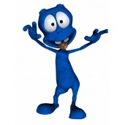
kilb

Slide 29
lang

Slide 30
zoa

Slide 31
mith

Slide 32
lox

Slide 33
He went to the zoo.

Slide 34
Tuesday

Slide 35
s
a
p
n
m
d
g
o
c
t
i
k
e
u
r
h
b
f
ff
l
ll
ck
w
x
y
z
zz
ch
ss
j
v
sh
th
ng
ai
ee
igh
oa
oo

Slide 36
oo

Slide 37
Set 1

Slide 38
book

Slide 39
cook

Slide 40
took

Slide 41
good

Slide 42
nook

Slide 43
book

Slide 44
took

Slide 45
cook

Slide 46
good

Slide 47
nook

Slide 48
Set 2

Slide 49
zoo

Slide 50
boom

Slide 51
boot

Slide 52
food

Slide 53
zoom

Slide 54
Set 3

Slide 55
he

Slide 56
we

Slide 57
me

Slide 58
be

Slide 59
she

Slide 60
Set 4

Slide 61
lig

Slide 62
gax

Slide 63
chot

Slide 64
mep

Slide 65
shov

Slide 66
The zoo keepers were all good.

Slide 67
Wednesday

Slide 68
s
a
p
n
m
d
g
o
c
t
i
k
e
u
r
h
b
f
ff
l
ll
ck
w
x
y
z
zz
ch
ss
j
v
sh
th
ng
ai
ee
igh
oa
oo
oo

Slide 69
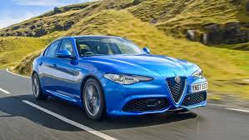
ar

Slide 70
Set 1

Slide 71
art

Slide 72
hard

Slide 73
chart

Slide 74
card

Slide 75
farm

Slide 76
art

Slide 77
hard

Slide 78
chart

Slide 79
card

Slide 80
farm

Slide 81
Set 2

Slide 82
book

Slide 83
took

Slide 84
cook

Slide 85
good

Slide 86
nook

Slide 87
Set 3

Slide 88
he

Slide 89
we

Slide 90
me

Slide 91
be

Slide 92
she

Slide 93
Set 4

Slide 94
nist

Slide 95
prob

Slide 96
rend

Slide 97
jup

Slide 98
nath

Slide 99
The pigs eat all the food on the farm.

Slide 100
Thursday

Slide 101
s
a
p
n
m
d
g
o
c
t
i
k
e
u
r
h
b
f
ff
l
ll
ck
w
x
y
z
zz
ch
ss
j
v
sh
th
ng
ai
ee
igh
oa
oo
oo
ar

Slide 102
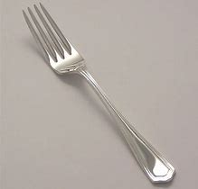
or

Slide 103
Set 1

Slide 104
for

Slide 105
sort

Slide 106
torn

Slide 107
born

Slide 108
short

Slide 109
for

Slide 110
sort

Slide 111
torn

Slide 112
born

Slide 113
short

Slide 114
Set 2

Slide 115
art

Slide 116
hard

Slide 117
chart

Slide 118
card

Slide 119
farm

Slide 120
Set 3

Slide 121
he

Slide 122
we

Slide 123
me

Slide 124
be

Slide 125
she

Slide 126
Set 4

Slide 127
stid

Slide 128
tron

Slide 129
vist

Slide 130
shap

Slide 131
moof

Slide 132
Can you sort the forks?

Slide 133
Friday

Slide 134
s
a
p
n
m
d
g
o
c
t
i
k
e
u
r
h
b
f
ff
l
ll
ck
w
x
y
z
zz
ch
ss
j
v
sh
th
ng
ai
ee
igh
oa
oo
oo
ar
or

Slide 135
Read the word twice, cover the word and write the word… ☺

Slide 136
zoo

Slide 137
boom

Slide 138
book

Slide 139
took

Slide 140
hard

Slide 141
chart

Slide 142
for

Slide 143
sort

Slide 144
The end for this week. Have a lovely weekend ! From Miss Bryant x ☺

